Slide 1
Redux
Based on materials I used during Udacity React Nanodegree program
Vsevolod malishev

Slide 2
Redux
Why Redux?
I’ll explain what makes Redux great. You’ll learn how Redux implements single source of truth, how it supports predictability in apps, and which JavaScript techniques it uses to influence state.
Redux At Its Core
You’ll take a closer look at the three core elements of Redux: actions, reducers, and the store.
React & Redux
You’ll combine Redux with your React skills to extend the functionality in your apps. You’ll also leverage the react-redux bindings, as well as review additional functional JavaScript techniques.

Slide 3
redux
Architect A Redux Store
We’ll add additional properties to your application’s store leveraging reducer composition and state normalization to keep your apps optimized.
Redux MIddleware
We’ll add further enhancements to your apps using middleware software to intercept dispatched actions before reaching reducers. You’ll also learn about affective ways to organize app’s directory

Slide 4
What is redux?
Redux is a JavaScript library used to manage an application’s front-end state. Redux isn’t a requirement for React apps, but as web apps become more complex, bugs may arise from mismanaging state. Global state in Redux apps is held within a single source of truth: the store. Since updates to state are tightly controlled, this makes Redux very predictable.
In fact, one of the main reasons why developer love Redux is its predictability. Let’s see why!

Slide 5
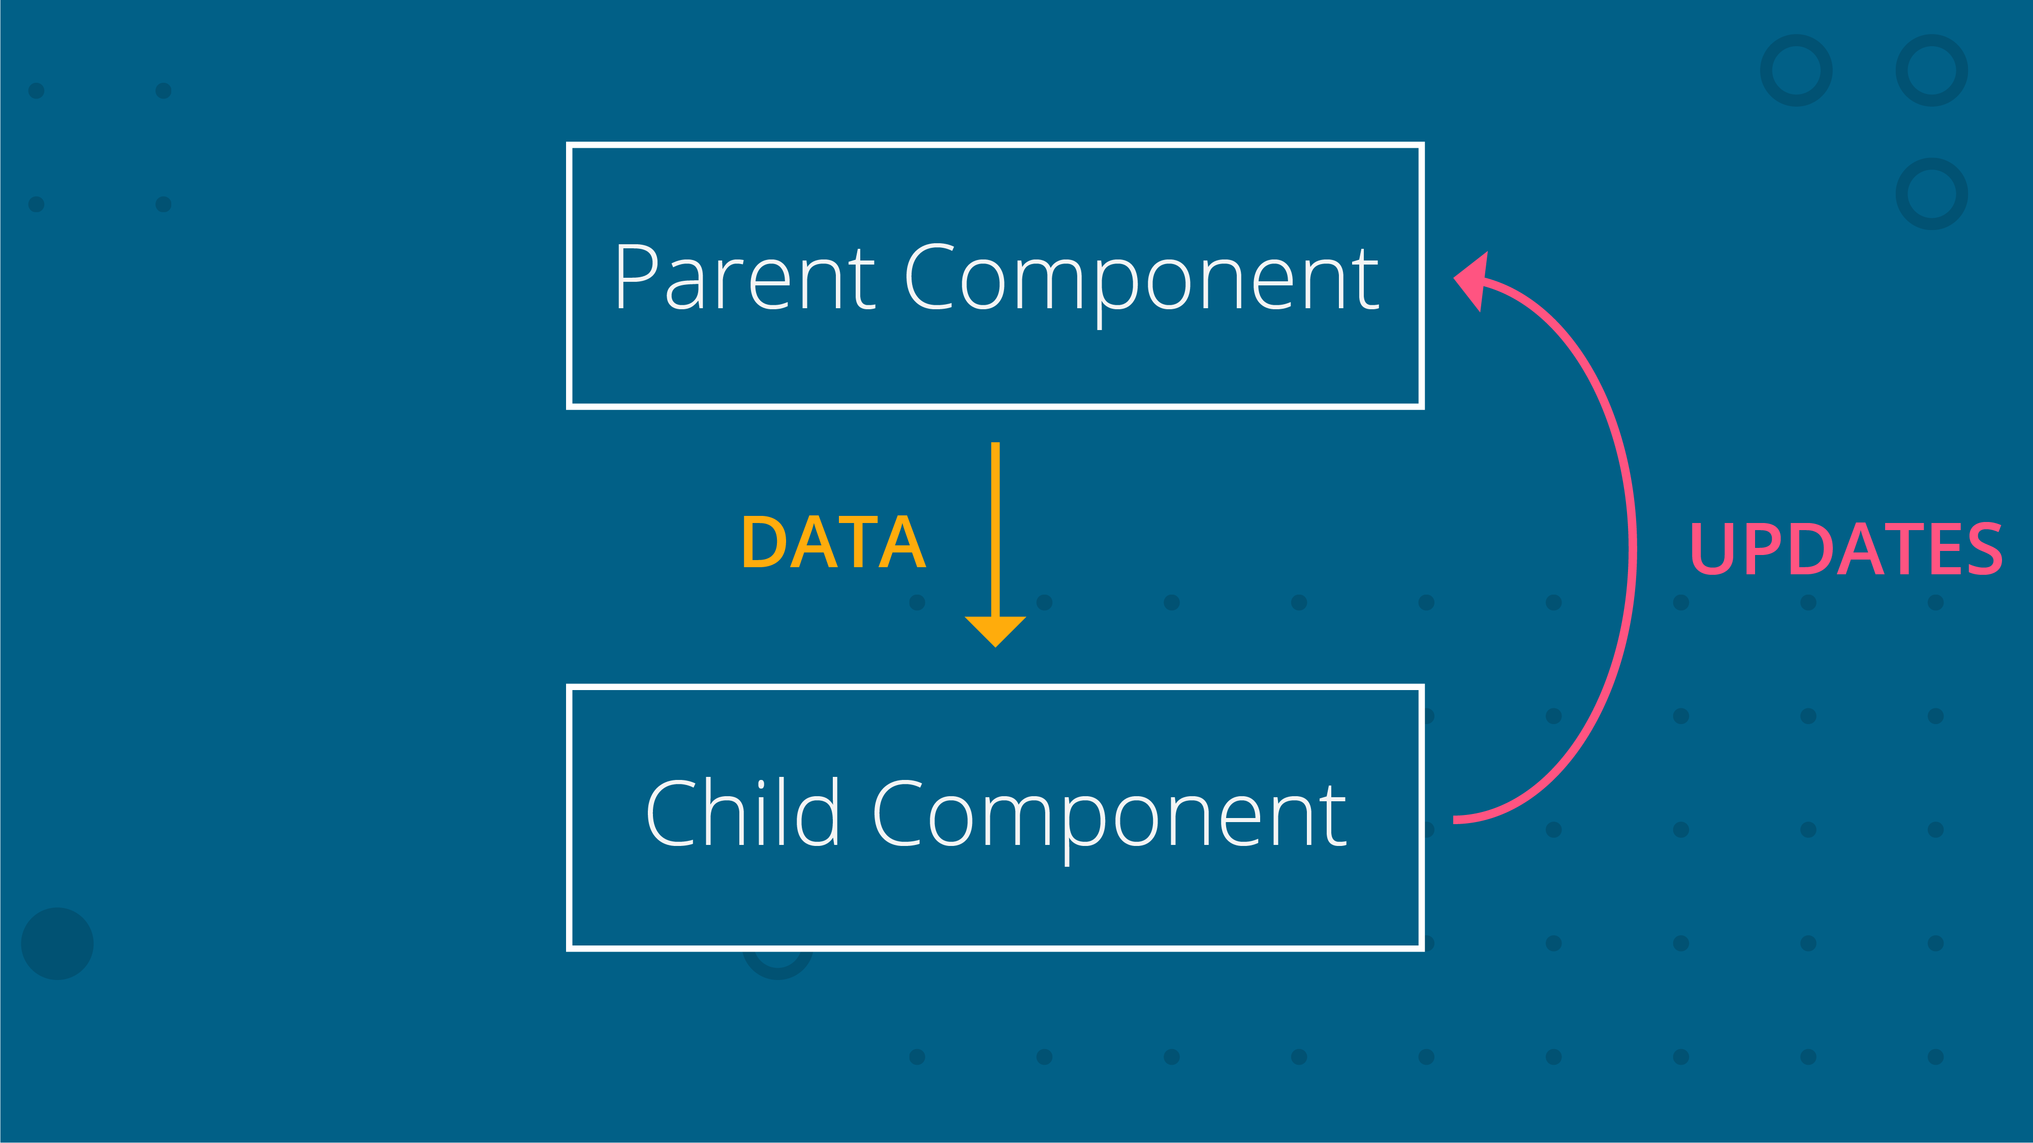
predictability
Recall that one of React’s core features is its unidirectional data flow:
Data flows down from parent component to child component. Data updates are sent to the parent component when the parent performs the actual change.

Slide 6
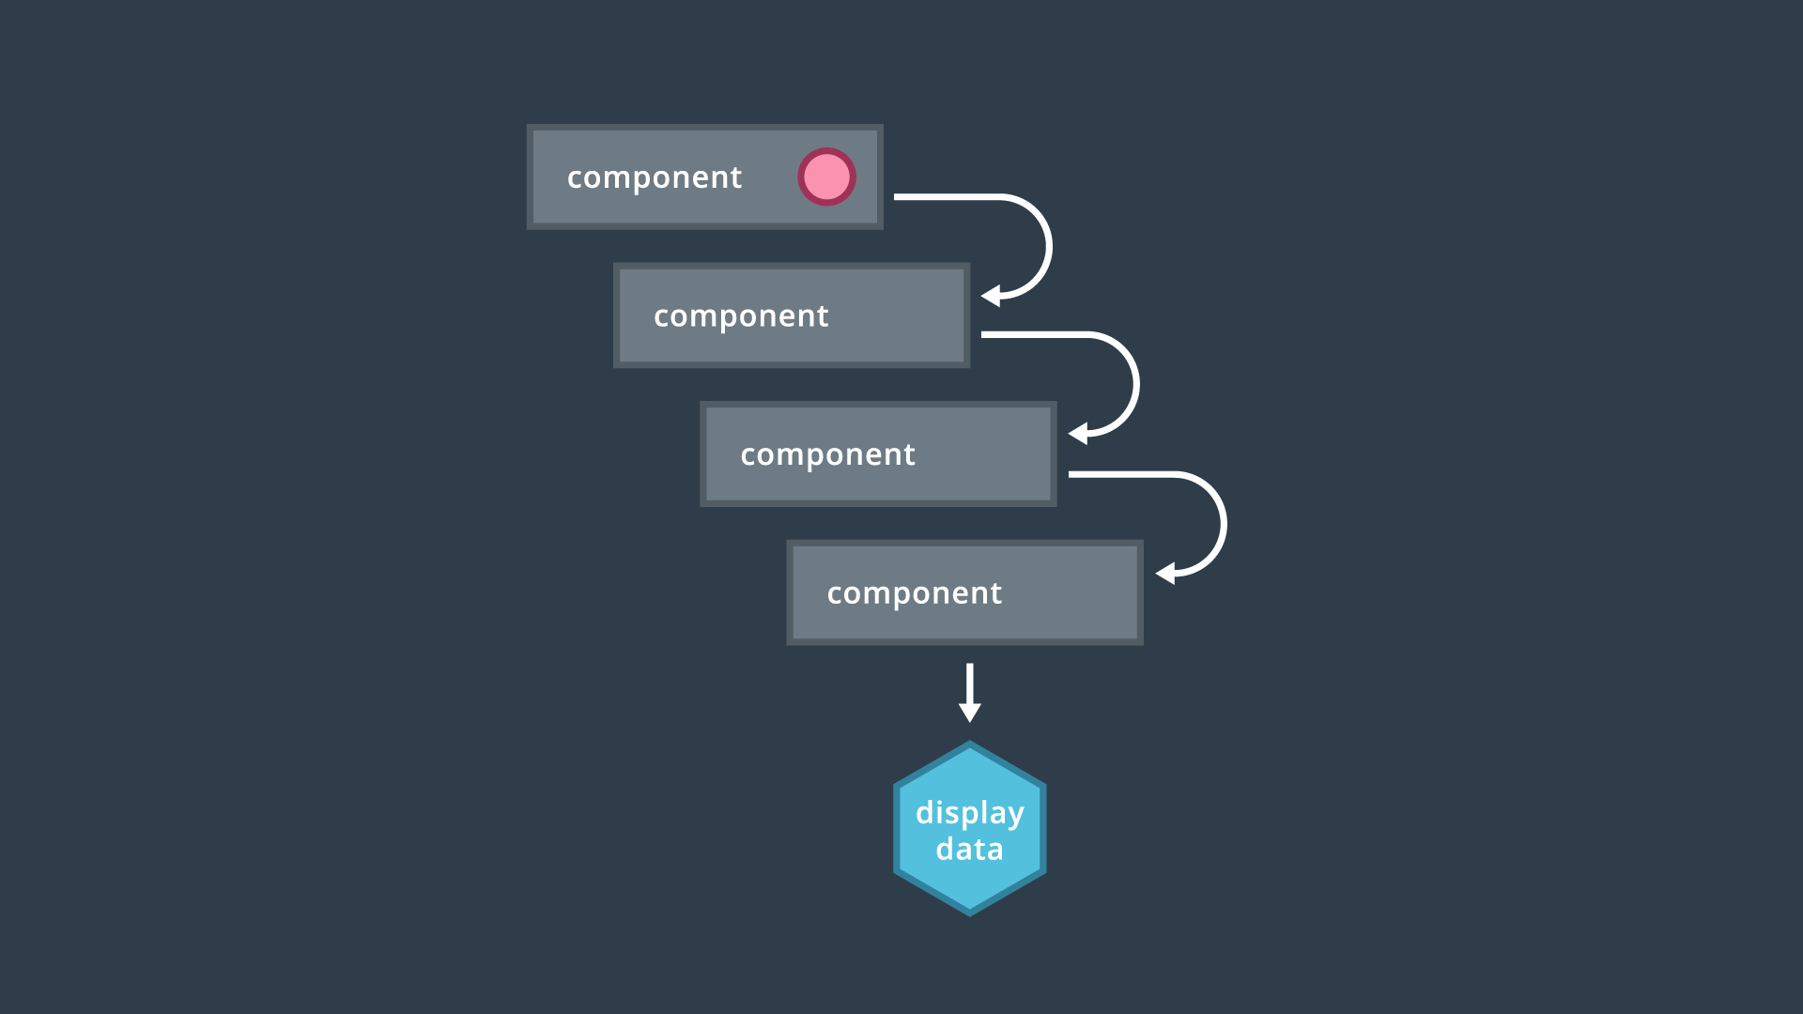
predictability
A nested component structure where the prop must be passed down through many components to be displayed.
- With deeply-nested component structures, data has to be passed down through all intermediary components!

Slide 7
Predictability
Redux improves predictability in web applications in several ways. That data is consolidated to one centralized location: the store. Components cannot write directly to data in that store; rather, they must request access to that data. Additionally, strict rules are set on how the store can be updated.
Redux adopts React's philosophy of having unidirectional data flow in its architecture.

Slide 8
Redux store vs component state
Which state where?
Redux is a powerful state container for web apps, but there is no hard-and-fast rule that all state must be contained in a Redux store. In fact, it may make sense to store some data in (React) component state, as well. It is ultimately up to you to decide what works best for your app, but there are also few common conventions that you can follow.
Redux Store
Generally, if state is shared and accessible through the whole app, it should be kept in the store. Examples include:
Cached users
A draft of an email

Slide 9
Redux store vs component state
Component State
On the other hand, if more "localized" data is involved, or you're dealing with state that doesn’t affect other components, component state is a solid choice. Examples include:
Form input
Current tab selected
Dropdown open/closed status

Slide 10
Redux store vs component state
Whichever you choose, just make sure it works for you and your app. As Dan Abramov suggests in the Redux docs:
“ There is no "right" answer for this... As a developer, it is your job to determine what kinds of state make up your application, and where each piece of state should live. Find a balance that works for you, and go with it.”

Slide 11
Redux state is read-only
Recall that state in a Redux store is read-only. Having this restriction benefits the app in several ways:
Predictability and reliability is improved
Side effects are prevented (more on this in the next section!)
The number of external resources writing to state is hindered
All changes are centralized and happen one-by-one in a strict order
The only way to change state, then, is to emit an action describing the intended change.

Slide 12
Redux store state
Though Redux provides a single source of truth, storing some data in a component’s internal state is absolutely fine. In the case of global state in a store, Redux imposes restrictions on when and how state updates can happen.
One of these restrictions states that only pure functions can update state in Redux apps. Let’s check them out!

Slide 13
Pure functions
What are Pure Functions?
Pure functions are integral to how state in Redux applications is updated. By definition, pure functions:
Return one and the same result if the same arguments are passed in
Depend solely on the arguments passed into them
Do not produce side effects

Slide 14
Pure functions
const square = x => x * x;
square() is a pure function because it outputs the same value every single time, given that the same argument is passed into it. There is no dependence on any other values to produce that result, and we can safely expect just that result to be returned -- no side effects (more on this in a bit!).
const tipPercentage = 0.15;
const calculateTip = cost => cost * tipPercentage;
// `calculateTip()` is an impure function

Slide 15
Pure functions
Pure functions are not exclusive to Redux (or even JavaScript), but they do support predictability in an application. In the next slides, we’ll learn more about how pure functions called reducers return an app’s new state. Reducers are based on Array’s reduce() method, so let’s check it out first!

Slide 16
Array’s .reduce() method
The central idea of .reduce() is that it takes in a large amount of data but returns a single value. .reduce() is a higher-order function, meaning that it takes in a function (i.e., a callback) as an argument.

Slide 17
Array’s .reduce() method
const musicData = [
{ sales: 1731000 },
{ sales: 1608000 },
{ sales: 1554000 },
{ sales: 1085000 }
];
let totalAlbumSales = musicData.reduce((total, currentValue) => {
return total + currentValue.sales;
},0);
.reduce() is a powerful method that allows you to reduce a large set of data to a single value. Redux leverages this very same principle, using reducers to update its data store. We’ll check them out in the next slides!

Slide 18
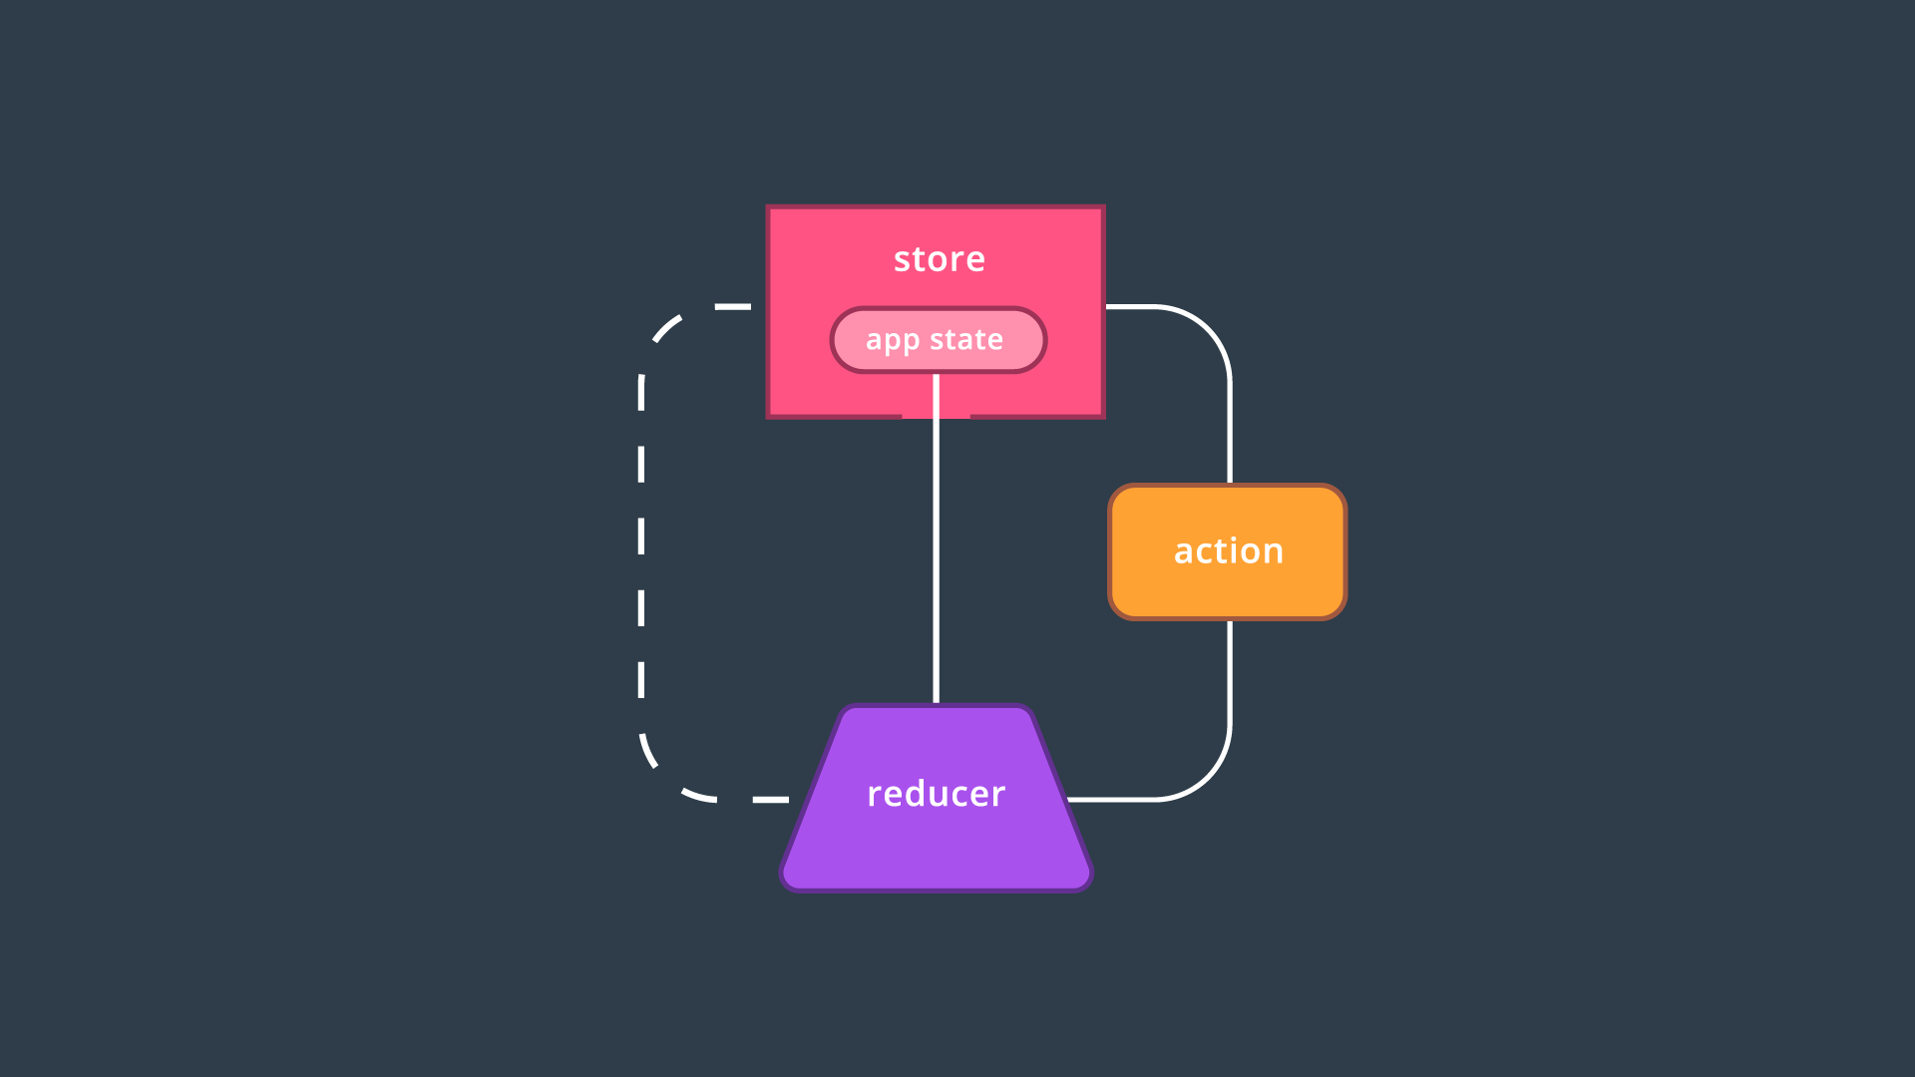
Redux at its core
All Redux elements are interconnected, with the store being the central element
As you can see, there are three main parts to Redux:
Actions
Reducers
The store

Slide 19
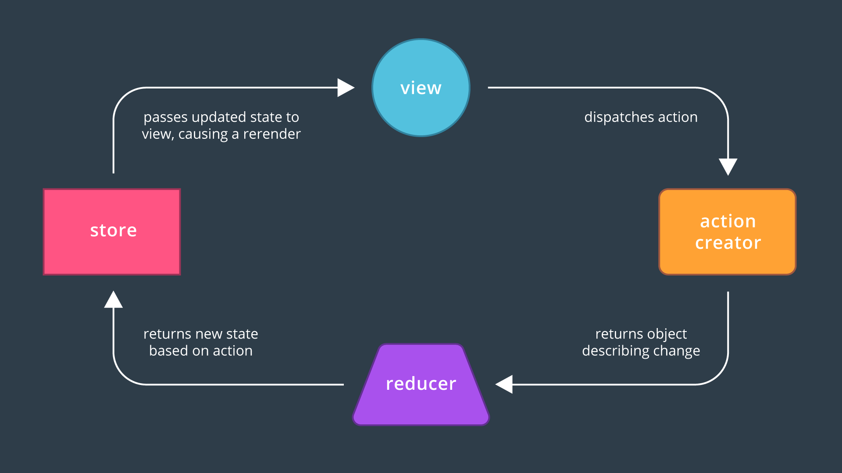
Redux at its core
Most of the application's data or state lives in the store. The store's data is populated by reducers (there can be more than one reducer, but we're only showing one in the image). An action is "dispatched" by the store and is what's used by reducers to determine what data they should output. For clarity, there also can (and will be!) more than just one action in a Redux application.

Slide 20
Redux at its core
The whole goal of Redux is to make state management in your application more manageable. Typically, you use Redux in combination with React. However, they don't have to be used together. Redux can really be used in any application that needs help managing state.
The main concepts of Redux are actions, reducers, and the store. The store is the source of truth for the state in your application, reducers specify the shape of and update the store, and actions are payloads of information which tell reducers which type of events have occurred in the application.

Slide 21
Create actions
Actions in Redux are JavaScript objects that you set up to describe any event in your application that should update your application’s state.
const LOAD_PROFILE = 'LOAD_PROFILE';
const loadProfileAction = {
type: LOAD_PROFILE
};

Slide 22
Create actions
Plain objects aren't very portable, so in order to make actions more portable and easy to test, they’re usually wrapped in functions called "action creators". These actions aren’t modifying the state themselves; instead, they’re just specifying that some event occurred which should update the state. It is important to keep actions as concentrated as possible, free of side effects.
const loadProfile = user => ({
type: LOAD_PROFILE,
user
});

Slide 23
Create reduces
Reducers are just functions; they receive the current state and an action object, they must be a pure function, and they should always return either the new state or the previous state.
function myReducer (state = initialState, action) {
if (action.type === CHANGE_NAME) {
return { ...state, name: ’Tim' };
}
return state;
}
Store your state in Redux if two components rely on the same piece of state, or if the operation to get that state was expensive.

Slide 24
Create redux store
In order to create a store, you pass a reducer function to Redux’s createStore() method as the first argument. What’s returned from createStore() is the store itself, which has three properties on it:
getState()
dispatch()
subscribe()
getState()
store.getState() doesn’t take any arguments and will return the current state of the store.
dispatch()
store.dispatch(action) takes in an action object and will call the reducer function, passing it the current state and the action which was dispatched. For example:

Slide 25
Create redux store
import { createStore } from 'redux';
import reducer from '../reducers/reducer';
let store = createStore(reducer);
const receiveComment = comment => ({ type: 'RECEIVE_COMMENT', comment });
export default store;
store.getState(); // []
store.dispatch(receiveComment('Redux is great!'));
store.getState(); // ['Redux is great!']

Slide 26
Create redux store
subscribe()
store.subscribe(cb) takes in a listener callback function that will be invoked whenever the state of the store changes.

Slide 27
Redux at its core
We covered a lot so far. To recap:
The reducer is responsible for deciding the shape and the initial state of the store and when an action is dispatched, the state it returns will become the new state of the store.
The state of Redux is stored in the Store.
An action is a payload of information describing state changing events that occur in the application.
The store can be used to dispatch actions, get the current state of the store, and subscribe to any changes.
Now, let's connect your Redux app to React via the react-redux bindings!

Slide 28
React & redux
Up until this point, we’ve only used "vanilla" Redux. That is, everything so far has been agnostic in regards to any sort of framework or view library.
To recap, earlier we created a store with createStore(), passing it a reducer function. Then we learned how to use dispatch(), getState(), and subscribe() to hook up Redux to a React app. We have to pass the store down to the main component in order to get access to dispatch(), getState(), and subscribe(). This worked fine for a small application, but it doesn't scale well with additional components.
This doesn’t mean Redux is ineffective; we just don’t have the right abstraction. Until this point we’ve been learning about low-level Redux methods and trying to use those with React. What if there were a better abstraction, one specifically for using Redux with React? Good news! There is, and it’s called react-redux, made by the creators of Redux itself.
The biggest benefit of react-redux is when dispatching actions and accessing the Redux store from inside of your React components. This is all possible through react-redux's Provider component and the connect() method.
connect() allows you to specify which components should receive which data from the store and Provider makes connect() work properly.

Slide 29
provider
Provider makes it possible for Redux to pass data from the store to any React components that need it. It uses React’s context feature to make this work.
Components that need access to the store, however, still need a way to “connect” to it. We mentioned the connect() function earlier, which utilizes a technique in functional programming called currying. Before we see connect() in action, let’s take a closer look at how currying works!

Slide 30
curring
Currying is the process of partially providing the input to a function that requires additional data. The part of the Redux API that uses currying is its connect() method. Let's take a look!
const houseBuilder = (floors) => {
return (color) => {
return `building a ${floors}-story, ${color} house`
}
}
const response = houseBuilder(3)('blue');

Slide 31
provider
Import { Provider } from ‘react-redux’
ReactDOM.render(
<Provider store={ store }>
<App/>
</Provider>, document.getElementById(‘root’)
)

Slide 32
connect
connect() connects a React component to the Redux store. mapStateToProps() allows us to specify which state from the store you want passed to your React component. mapDispatchToProps() allows us to bind dispatch to your action creators before they ever hit your component.
connect(mapStateToProps, mapDispatchToProps)(MyComponent)
mapStateToProps()
mapStateToProps() allows you to specify which data from the store you want passed to your React component. It takes in the store's state, an optional ownprops argument, and returns an object. Check out its complete signature:
mapStateToProps(state, [ownProps])

Slide 33
connect
import { connect } from 'react-redux';
const User = ({ name, age }) => { // ... };
const mapStateToProps = (state, props) => ({
name: state.user.name,
age: state.user.age
});
export default connect(mapStateToProps)(User);

Slide 34
connect
mapDispatchToProps()
When you connect a component, that component will automatically be passed Redux's dispatch() method.

Slide 35
connect
class User extends Component {
state = { name: '' }
handleUpdateUser = () => { this.props.boundUpdateName(this.state.name) }
render () { // ... } }
const mapDispatchToProps = dispatch => ({
boundUpdateName: (name) => dispatch(updateName(name))
});
export default connect(null, mapDispatchToProps)(User);

Slide 36
React & redux
When you use React with Redux, you’ll want to use the react-redux bindings. The biggest parts of react-redux are Provider and connect. connect allows you to specify which components should receive which data from the store and Provider makes connect work properly.

Slide 37
Architect redux store
Reducer Composition
As an application grows, so will the need for multiple reducers to manage different aspects of the Redux store. The problem is that Redux’s createStore() method takes in a single reducer, not multiple. To combine all of your reducers into one, you can use Redux’s combineReducers() method. This allows you to use reducer composition to manage the state in your store.
export default combineReducers({
usersReducer,
booksReducer
});
...
import rootReducer from ‘../reducers’
const store = createStore(rootReducer)

Slide 38
Architect redux store
Normalization
When architecting a Redux store, there are two things you should keep in mind:
Do not duplicate data. If data lives in multiple places, you have no single source of truth, and you waste resources trying to keep the data in sync with each other.
This pattern is beautifully summarized in the Redux docs:
"In a more complex app, you’re going to want different entities to reference each other. We suggest that you keep your state as normalized as possible, without any nesting. Keep every entity in an object stored with an ID as a key, and use IDs to reference it from other entities, or lists.”

Slide 39
Architect redux store
Normalization
Keep your store as shallow as possible. Nested data makes reducer logic more complicated (trying to update deeply nested data can get slow and complex quickly).
By referencing different entities in your state and keeping your state as shallow as possible, you increase performance and make your code much easier to reason about.

Slide 40
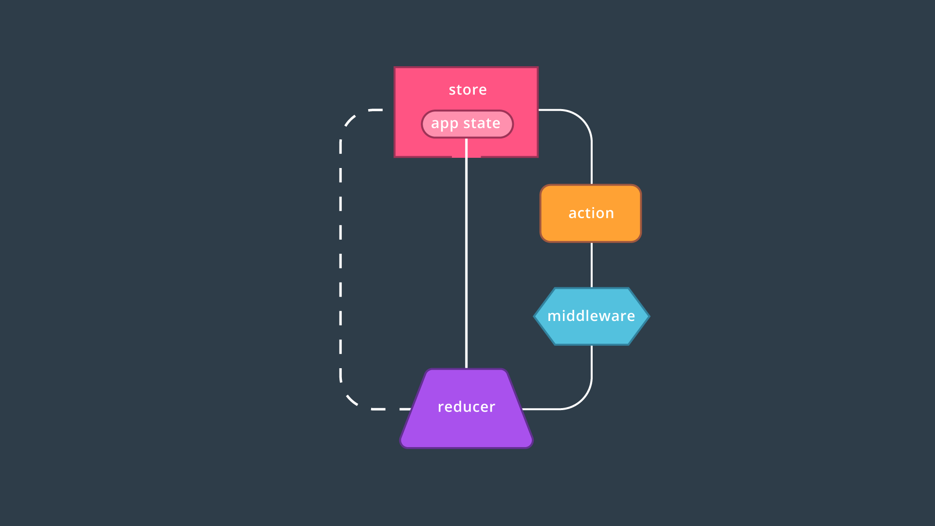
middleware
As the Redux doc describe, middleware is a third-party extension point between dispatching an action and the moment it reaches the reducer.

Slide 41
middleware
Middleware and Redux
You’ve learned how the unidirectional flow of data supports predictability in Redux applications: in order to change the store’s state, an action describing that change must be dispatched to the reducer. In turn, the reducer returns the new state.
Between the dispatching of actions and the reducer, we can introduce software called middleware to intercept the action before it ever reaches the reducer. As the Redux docs describe it, you can think of middleware as:
…a third-party extension point between dispatching an action, and the moment it reaches the reducer.

Slide 42
middleware
Middleware and Redux
Once middleware receives the action, it can then carry out a number of operations, including:
Producing a side effect (e.g., logging state)
Processing the action on its own (e.g., making an asynchronous HTTP request)
Redirecting the action (e.g., to another piece of middleware)
Running some code during the dispatch
Dispatching supplementary actions
...and it can do any of this before passing the action along to the reducer!

Slide 43
middleware
Implementing Middleware
Recall that the createStore() method is used to create the Redux store. Aside from passing in a reducer (oftentimes the combined "root reducer"), createStore() can also take in an optional enhancer argument, as well! Here is the method signature for createStore():
store.createStore(reducer, [preloadedState], [enhancer])
Redux provides us with the applyMiddleware() function that we can use as our enhancer argument. applyMiddleware() can accept multiple arguments, so if needed, we can apply more than one middleware to an app.

Slide 44
middleware
Thunks
Out of the box, the Redux store can only support the synchronous flow of data. Using middleware like thunk helps support asynchronicity in a Redux application. You can think of thunk as a wrapper for the store’s dispatch() method; rather than returning action objects, we can use thunk action creators to dispatch functions or Promises.
Note that without thunks, synchronous dispatches are the default. That is, we could still make API calls from React components (e.g., using the componentDidMount() lifecycle method to make these requests), but we strive for two things in Redux apps:
Reusability (think composition)
Predictability, in which only action creators can be the source of each state update
Let’s see how it all works!

Slide 45
middleware
Thunks
Installation
In order to use thunk middleware in an app, be sure to install the redux-thunk package:
npm install --save redux-thunk

Slide 46
middleware
Thunk Action Creator Example
Let’s say that we’re building a web app that stores a user’s to-do items. After the user logs in, the app needs to fetch all of the user’s to-dos from a database. Since Redux only supports the synchronous flow of data, we can use thunk middleware to asynchronously produce the HTTP request for this fetch action.
Before we can write our thunk action creators, let’s make sure our store is ready to receive middleware:

Slide 47
middleware
// store.js
import { createStore, applyMiddleware } from 'redux';
import thunk from 'redux-thunk';
import rootReducer from '../reducers/root_reducer';
const store = () => createStore(rootReducer, applyMiddleware(thunk));
export default store;
Here, everything is set up for thunk middleware to be applied to the store: thunk middleware is imported from redux-thunk, and an instance of thunk is passed to the Redux’s applyMiddleware() enhancer function.
Additionally, let's say that the HTTP request looks like the following:

Slide 48
middleware
// util/todos_api_util.js
export const fetchTodos = () => fetch('/api/todos');
Since thunk middleware allows us to write asynchronous action creators that return functions rather than objects, our new action creator can now look like:

Slide 49
middleware
// actions/todo_actions.js
import * as TodoAPIUtil from '../util/todo_api_util';
export const RECEIVE_TODOS = "RECEIVE_TODOS";
export const receiveTodos = todos => ({ type: RECEIVE_TODOS, todos });
export const fetchTodos = () => dispatch => (
TodoAPIUtil.fetchTodos().then(todos => dispatch(receiveTodos(todos)))
);

Slide 50
middleware
Under the hood, thunk middleware intercepts actions of the type function before the dispatch is generated. In addition to dispatch, getState is also passed in as a second argument; this allows thunk action action creators to read the current state of the store.
If a web application requires interaction with a server, applying middleware such as thunk helps solve the issue of asynchronous data flow. Thunk allows us to write action creators that return functions (rather than objects). The thunk can then be used to delay an action dispatch, or to dispatch only if a certain condition is met (e.g., a request is resolved).

Slide 51
App structure and organization
Aside from using middleware, we can also enhance our app in perhaps a more ancillary manner by choosing how we structure our file paths. After all, there are many moving parts and dependencies when it comes to Redux apps -- actions, reducers, the store, components, API utilities -- the list goes on.
By consciously thinking about how we organize our app’s assets, not only can we make it easier to find files we’re looking for, we can also make it easier to move things around (i.e., modularity). Here are two great ways that you can organize the directory structure when building Redux apps:

Slide 52
App structure and organization
Organization by Capability ("Type”)
Frontend
Components
component1.js
component2.js
component3.js
Actions
action1.js
action2.js
Reducers
reducer1.js
Util
Store

Slide 53
App structure and organization
Organization by Feature
Frontend
Nav
actions.js
index.js
reducer.js
Dashboard
actions.js
index.js
reducer.js

Slide 54
Questions?

